Slide 1
3rd Grade PSR
Remote Learning Chapter 8 & 9
Sunday 8, Nov 2020

Slide 2
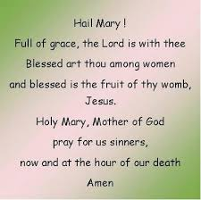
Say the Our Father & One Hail Mary

Slide 3
The Church has 4 Marks
The Church is One
The Church is Holy
The Church is Catholic
The Church is Apostolic
Holy Holy Holy by Hillsong: https://youtu.be/UvRp_xKLP8I

Slide 4
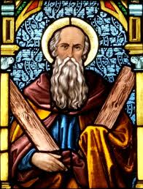
This Week’s Saint: Saint Andrew
Apostle and older brother to St. Peter
It is said that Andrew was a disciple of John the Baptist
When Jesus walked by one day, John the Baptist stated, “Behold the lamb of God!”. It is then that Andrew and another made the decision to follow Jesus.
It is believed that Andrew was one of the closer disciples of Jesus. John 6:8 – Andrew told Jesus about the boy with loaves and fish.
When Phillip wanted to speak to Jesus about Greeks seeking him, he spoke to Andrew first.
Andrew was present at the last supper.
Andrew was crucified on and X shaped cross, this is now known as Andrew’s cross.
Feast Day is November 30th
Patron Saint of Fisherman, singers, Scotland, Russia, Ukaraine, and Patras
(resource: https://www.catholic.org/saints)

Slide 5
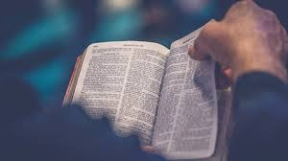
Chapter 8 Read Aloud Pages 76 & 77
Jesus chose the Apostles to lead the Church
Key Words: BISHOPS, DIOCESES, POPE, MARKS OF THE CHURCH
The Apostles: Peter, Andrew, James and John (sons of Zebedee), James (the son of Alphaeus) Philip, Bartholomew, Thomas, Matthew, Thaddeus, Simon, and Judas Iscariot. Lather Matthias too the place of Judas
Bishops are the successors of the Apostles. The bishops continue to lead the Church. They lead local areas of the Church called dioceses.
St. John’s, our church, is apart of the Archdiocese of Cincinnati.
The pope is the bishop of the diocese of Rome in Italy. He continues the leadership of Peter. Together with all the bishops, he leads and guides the whole Catholic Church
Say a silent prayer of thanks for your Church Community and the bishops of all churches across the world

Slide 6
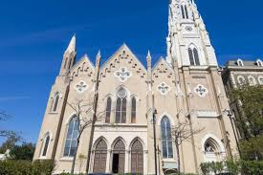
Chapter 8 Read Aloud Page 78 & 79
The Church is one faith community that is united by Baptism
All Catholics receive a share in God’s life through their Baptism.
Celebrating the sacraments and loving God and others helps us grow in holiness.
What does the word ‘catholic’ mean? All people are welcomed to become members of the church.
What does the word ‘apostolic’ mean? Comes from the Apostles; to be sent to teach the Good News and baptize new members.

Slide 7
Chapter 9 The Church Teaches us Read pages 84 & 85
The Church is the Body of Christ and the People of God.
Saint Paul explained to the people that the Church is the Body of Christ on earth.
Everyone in the Church is an important part of the Body of Christ. We are united through our love for and belief in Jesus Christ.
God has chosen us to be his children, brothers and sisters of Jesus.
Who is in the Body of Christ? The pope, biships, priests, all baptized people all over the world, the saints, and those who have died.

Slide 8
Apostle’s creed Read Aloud the Apostle’s Creed
We state our belief in the Blessed Trinity: God the Father, God the Son, and God the Holy Spirit
We state our belief that God the Son, the Second Person of the Blessed Trinity, became on of us and died to save us.
We state or belief in the holy Catholic Church that Jesus gave us. When we pray the Apostles’ Creed we say together as the Church that we are one in faith and love.

Slide 9
Chapter 9 Read page 86 & 87 (remember to read the As Catholics box)
The Holy Spirit guides the Church
How can we reflect Catholic beliefs?
Look for God in everyone
Be aware of God’s presence
Be respectful
Be helpful to all
At certain times the pope gathers together all the bishops throughout the world. They make important decisions about the Church’s faith and life.
Name something you have learned about Jesus and the church. Who taught you?
Learning about the faith requires listening, studying, and then putting into practice what has been taught.
Justice is treating everyone fairly and with respect.
God loves and cares for everyone (so should we)
We are to love God with our whole heart.
We are to love our neighbors as ourselves.

Slide 10
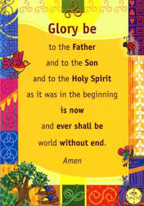
Prayer
Hopefully you recited the Our Father and one Hail Mary
Please recite the glory be
Let me know if you do have any prayer intentions.

Slide 11
Weekly Assignment
NO TEST this week! Once you have completed this lesson, please email me that you have finished it. ☺
Pages 80, 81, 88, 89 – are for fun if you so chose
We will be doing a couple chapters together to line us up for the start of advent.
Other resources
Contact info: Jennie Palmer – 513-349-1178 jennie.palmer@gmail.com
You Are Loved by Stars go Dim : https://youtu.be/-YbdaR7Plac
God Bless you and keep you all safe. I am here for whatever you need at all. Please do not hesitate to reach out.

