Slide 1
3rd Grade PSR
Remote Learning Chapter 15
Sunday 13, Dec 2020

Slide 2
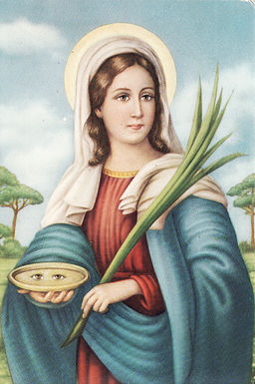
This Week’s Saint: Saint Lucy
Lucy's history has been lost and all we really know for certain is that this brave woman who lived in Syracuse lost her life during the persecution of Christians in the early fourth century.
The story of a young Christian woman who vowed to live her life in service of Christ. Her mother tried to arrange a marriage for her with a pagan and Lucy knew her mother could not be swayed by a young girl's vow, so she devised a plan to convince her mother that Christ was the better partner for life.
After several prayers at the tomb of Saint Agatha, Lucy saw the saint in a dream. St. Agatha told Lucy her mother's illness would be cured through faith, which Lucy used to persuade her mother to give the dowry money to the poor and allow her to commit her life to God.
The man that she was to marry was very upset that she did not marry him and he reported her faith to the governor of her time. Lucy would become a martyr because of her love and commitment to Christ.
Legend has it that Lucy lost her eyes during her death ordered by the governor, but when they buried her it was found that her eyes were restored.
Feast Day is December 13th
Patron Saint of blindness
(resource: https://www.catholic.org/saints)

Slide 3
Apostle’s creed Read Aloud the Apostle’s Creed

Slide 4
We Celebrate the Sacraments
The Sacraments are signs of God’s Love for Us.
What are the 7 Sacraments?
Little Drummer Boy by Pentatonix: https://youtu.be/qJ_MGWio-vc

Slide 5
Chapter 15 Read Aloud Pages 132 & 133
Key Words: SACRAMENT, GRACE, SACRAMENTS OF CHRISTIAN INITIATION, ORIGINAL SIN
A Sacrament is a special sign given to us by Jesus through which we share in Gods life and love.
The Church celebrates seven special signs called sacraments:
Baptism
Confirmation
Eucharist
Penance and Reconciliation
Anointing of the Sick
Holy Orders
Matrimony
Sacramentals are blessings, actions, and special objects given to us by the Church.
Blessings of People, Places, and food are sacramentals.
Actions such as making the Sign of the Cross and the sprinkling of holy water are sacramentals
Some objects that are sacramentals are statues, medals, rosaries, candles, and crucifixes
While on earth, Jesus showed us signs of God’s love by welcoming and blessing the children, healing the sick, and forgiving sinners
Our share in God’s life and love is called Grace

Slide 6
Chapter 15 Page 133 & 134
Each of us Is born with Original Sin, the first sin committed by the first human beings. Through Baptism God frees us from Original Sin and forgives any sins we may have committed. God fills us with grace, his life, and love.
In Confirmation we are sealed with the Gift of the Holy Spirit. The Holy Spirit gives us strength and courage to live as disciples of Jesus.
In the Eucharist we praise and thank God the Father for sending his Son, Jesus. Look up bible verse John 3:16
Sacraments of Christian Initiation: Baptism, Confirmation, and Eucharist.

Slide 7
Chapter 15 Page 134
Penance and Reconciliation and Anointing of the Sick are Sacraments of Healing
Confession/Reconciliation – sometimes we are afraid to confess our sins because we can fear that God will punish us and NOT forgive us. This is really important!... Sin pulls us away from God, so when we go to confession even though we don’t want to and the closer we get to it we have so many doubts coming to us, but that is the enemy working against us because the enemy knows that once we go and tell Jesus our sins that he is going to forgive us, and when He forgives us WE ARE HEALED! Sacrament of HEALING not the sacrament of punishment! Jesus wants us close to him, so he will forgive us because He loves us and wants us with Him always. We should want to go to confession so that our souls can be healed and we can mend our relationship and get closer to the Lord. Next time you go to confession be happy and excited knowing soon you will be healed and that there is nothing that you can do that will make Jesus stop loving you.
Shoulders by for King and Country: https://youtu.be/TfiYWaeAcRw

Slide 8
Chapter 15 Page 135
Holy Orders and Matrimony are Sacraments of Service to others
We each have a vocation to serve God and the Church.
The church celebrates two sacraments that are special signs of service: Holy Orders and Matrimony.
In the sacrament of Matrimony, husbands and wives are strengthened by God to love and respect each other, share love with their families and to serve others together.
In the sacrament of Holy Orders: baptized men are ordained to serve the Church as deacons, priests, and bishops. This sacrament gives them the grace to live out their vocation of service in the Church. Hierarchy order:
Pope
Archbishop
Bishop
Priest
Deacon

Slide 9
Examination of Conscience
□ I was disrespectful of God
□ I didn’t listen to my parents or teacher or someone else in charge
□ I used mean words
□ I didn’t tell the truth
□ I too what was not mine
□ I was rude
□ I teased or bullied someone
□ I purposely hurt someone
□ I did not clean up my mess
□ I was selfish or did not share
□ I ignored someone in need of help
□ I fought my brother or sister
□ I complained, whined, or begged
□ I did not apologize when I did something wrong
□ I was wasteful
□ I did not do my homework or my chores
□ I would not forgive someone who was sorry
□ I did not respect my body by eating unwell, not going to bed at bedtime to get good rest.
□ I did not pray every day
□ ____________________________ something I want to bring to Jesus that is not on this list
□ ____________________________ something I want to bring to Jesus that is not on this list

Slide 10
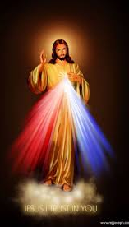
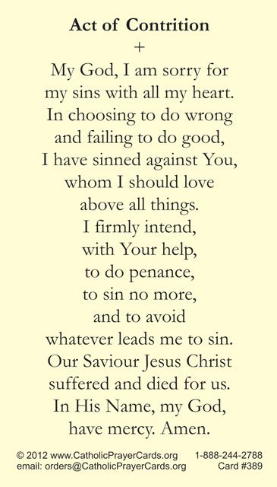
Review the Examination of Conscience. Mark what sins you may have committed. Even though you are not going to church right now, you can still ask for forgiveness. Pray to Jesus, confess your sins, and say the Act of Contrition. When you start going back to church you can go to the Sacrament of Reconciliation.

Slide 11
Weekly Assignment
Please turn in all missing items.
Verbally complete chapter 15 test
Please do the examination of conscience with your child, get them into the routine of seeing where they may be committing sins and how to ask for forgiveness. Somethings they do they don’t know that are sins, but once they realize it, they can still ask for forgiveness. God’s Mercy is one of the greatest gifts He has given us.
I will set up Zoom for next Sunday - I will send more information out at the end of next week.
Other resources
Contact info: Jennie Palmer – 513-349-1178 jennie.palmer@gmail.com
O Come, O Come Emmanuel by For King and Country: https://youtu.be/SkvYR4BcHYc
God Bless you and keep you all safe. I am here for whatever you need at all. Please do not hesitate to reach out.

