Slide 1
3rd Grade PSR
Remote Learning Chapter 10
Sunday 15, Nov 2020

Slide 2
The Church Prays
Quiet music helps us to calm down and be still – turn on the song quietly
Incense is a sign of prayer. Smoke rises, just as our prayers rise to God. Incense has a beautiful perfume. Our prayers are beautiful to God. Our church uses incense at different times throughout the year.
Pray the sign of the Cross – using the hand gestures as apart of your prayer.
Pick a person /people/ or a particular need to pray for, say your prayer out loud and end with Lord, let my prayer be incense before you. Psalm 141:2a
Pray by Sanctus Real: https://youtu.be/zrQHNQ0hwQE

Slide 3
Apostle’s creed Read Aloud the Apostle’s Creed

Slide 4
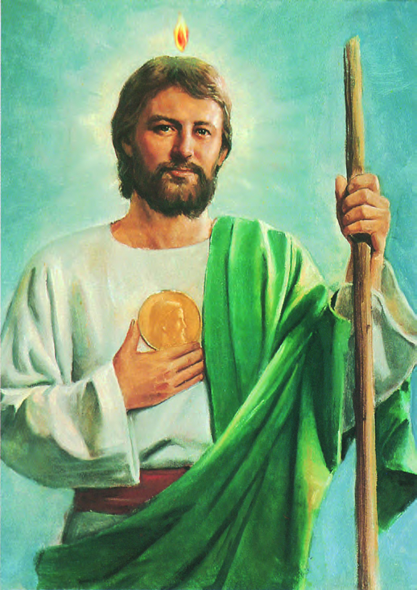
This Week’s Saint: Saint Jude Thaddaeus
Saint Jude, known as Thaddaeus, was related to Our Savior, he was a cousin of Virgin Mary.
One of the 12 Apostles of Jesus.
Images of St. Jude usually include a flame above his head, which represents his presence at the Pentecost, when he accepted the Holy Spirit
Saint Jude is NOT that same person as Judas Iscariot, who betrayed our Lord.
Legend claims that he visited Beirut and Edessa and could have been martyred with St. Simon in Persia.
Feast Day is October 28th
Patron Saint of desperate causes, desperate situations, lost causes
(resource: https://www.catholic.org/saints)

Slide 5
Chapter 10 Read Aloud Pages 92 & 93
Jesus teaches his followers to pray.
Key Words: PRAYER, SYNAGOGUE, LITURGY, PILGRIMAGES
Pray the Our Father
The Our Father or the Lord’s Prayer – is truly the summary of the whole gospel!!
Liturgy – is when we gather with others to celebrate the official public prayer of the Church. Each celebration of the liturgy is an action of the whole Church.

Slide 6
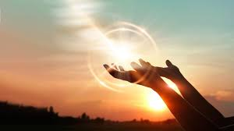
Chapter 10 Prayer
Look around – do you see a door?? A prayer is like a knock at the door.
“And I tell you, ask and you will receive; seek and you will find; knock and the door will be opened to you.” Luke 11:9
What is prayer? – Talking to God and LISTENING to God – when we pray, we should always take time to sit quietly and listen as well.
Start a journal – when you pray, take time to listen, and then take time to write a sentence or two. Put down your feelings before you started prayer, and how you felt after prayer. Did you think of something you didn’t think before? Did your heart feel something you didn’t feel before?
What did Jesus do when the disciples wanted to learn how to pray? He taught them the Our Father, to teach them how to pray.

Slide 7
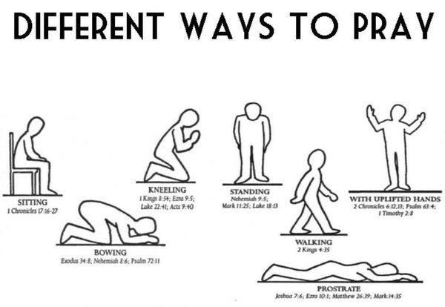
Chapter 10 Different Kinds of Prayer Read pages 94 & 95
Prayer of Praise – that WOW moment when you find something beautiful or precious you can turn that into a prayer of praise.
Prayer of Thanksgiving – when you feel grateful for something, when you are happy - you can turn that into a prayer of thanksgiving.
Prayer of Petition – when you know you have done something wrong, when we ask for God’s forgiveness that is a prayer of petition.
Prayer of Blessing – when we pray to God to bless our food before meals or someone we love that is a prayer of blessing
Prayer of Intercession – When we ask God to HELP our family, friends, and all people in the world that is a prayer of intercession.
Try different prayer postures to find what you are most comfortable doing:
Hands folded
Arms upraised with palms up
Kneeling
Laying down
Sitting
Standing
Walking

Slide 8
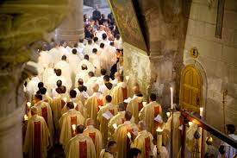
Chapter 10 (remember to read the As Catholics box)
The Church prays at all times
The Liturgy of the Hours is prayed at various times of the day.
At every moment of the day, Catholics are united in celebrating Mass and the sacraments.
There are many different prayer customs in the Church throughout the world. One of them is a pilgrimage, a prayer-journey.
Christians are never alone on their prayer-journeys. Jesus is always with them.
Make a prayer list – for the 5 different prayer types. Can you write a prayer that has all of the different types of prayers?
Pray in different prayer postures in your prayer space.
The more you pray the closer to God you get, you are building your relationship with Jesus and will be with you always.
Remember to always turn to God when you need Him and when you are thankful and happy. Jesus wants you to share your life with Him. He wants to get to know you and you to get to know Him

Slide 9
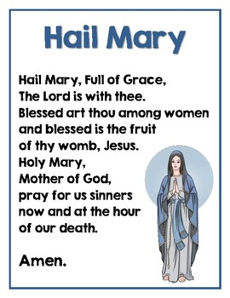
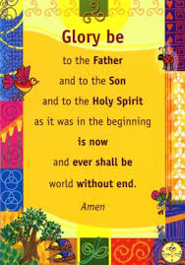
Prayer
You can pray the prayers that Are Already written and are ready for us to pray: like the Our Father, Glory Be, Hail Mary; or you can say your own prayers.

Slide 10
Weekly Assignment
Complete chapter 10 test on page 98. Due next Saturday 21Nov2020 – Please try to turn in all missing assignments by the first week of December.
Pages 96 and 97 – are for fun if you so chose
Write your own prayer that includes: Prayers for praise, thanksgiving, petition, blessing, and intercession.
Pray in your prayer space and try the different prayer postures
Start a prayer journal
Other resources
Contact info: Jennie Palmer – 513-349-1178 jennie.palmer@gmail.com
When we pray by Tauren Wells: https://youtu.be/9YZZzgJB33E
Lead me to the cross by Hillsong: https://youtu.be/StW6ZKHRCFo
God Bless you and keep you all safe. I am here for whatever you need at all. Please do not hesitate to reach out.

